Slide 1

CLR - BASICS
HOW TO WORKS CLR AND ITS COMPONENTS

Slide 2
Compilation
8.
CLR HEADER
CPU
9.
MethodDefToken: 0x000024
1.
6.
01011001010011101010
0101010010011001100
3.
IL CODE
5.
// Out.WriteLine(value); IL_0000: call class [System.Runtime]System.IO.TextWriter System.Console::get_Out() IL_0005: ldarg.0 IL_0006: callvirt instance void [System.Runtime]System.IO.TextWriter::WriteLine(string) // }
PE FILE
2.
STATIC VOID MAIN()
{
System.Console.WriteLine(“Hello world!”);
System.Console.WriteLine(“I love pizza”);
}
4.
JIT-COMPILER
7.

Slide 3
JITCompiler function
{
In the assembly that implements the type (Console), look up the method (WriteLine) being called in the metadata.
2. From the metadata, get the IL for this method.
3. Allocate a block of memory.
4. Compile the IL into native CPU instructions; the native code is saved in the memory allocated in step 5.
5. Modify the method’s entry in the Type’s table so that it now points to the memory block allocated in step 8.
6. Jump to the native code contained inside the memory block.
}

Slide 4
HOW TO WORK METADATA
PE METADATA HEADERS
STATIC VOID MAIN()
{
System.Console.WriteLine(“Hello world!”);
Canva.DrawSquare(50, 60);
}
static class Canva
{
static void DrawSquare(int x, int y)
{
// some code…
}
}
Name ResolutionScope
MemberRef: WriteLine 01000001
TypeRef: Console 23000001
AssemblyRef: System.Runtime
-----------------------------------------------------------------------------------------
Name
TypeDef: Canva MethodList:
Method: DrawSquare
Assembly: SomeNamespace

Slide 5
BLOCK DIAGRAM OF THE METADATA SEARCH ALGORITHM, USING THE CLR FILE OF THE ASSEMBLY, WHERE THE TYPE AND METHOD REFERRED TO BY IL - CODE
IL REFERS TO A TYPE
IL REFERS TO A MEMBER
AssemblyRef: Type is in different file, different assembly
WHAT DOES TYPEREF ENTRY INDICATE?
STRONGLY NAMED ASSEMBLY
SEARCH FOR ASSEMBLY IN GAC AND THEN APPBASE
WHAT DOES ASSEMBLYREF ENTRY INDICATE?
MODULEREF:
TYPE IS IN DIFFERENT
FILE, SAME ASSEMBLY
MODULEDEF:
TYPE IS IN THE SAME FILE,
SAME ASSEMBLY
EXAMINE MODULEREF TABLE AND LOAD APPROPIRATE FILE
WEAKLY NAMED ASSEMBLY
SEARCH FOR ASSEMBLY IN APPBASE
LOAD FILE WITH MANIFEST
TYPE IN MANIFEST FILE
WHAT DOES EXPORTEDTYPESDEF ENTRY INDICATE?
TYPE NOT IN MANIFEST FILE
CREATE INTERNAL TYPE STRUCTURE
LOAD FILE

Slide 6
MODULES
FILE RUT.CS
FILE FUT.CS
class Rut
{
public Rut(int dataPack) {
_dataPack = dataPack;
}
private int _dataPack;
}
class Fut
{
public int Sum(int a, int b)
{
return a + b;
}
}
CSC COMPILER
RUT.netmodule FUT.netmodule
PE FILE
MANIFEST

Slide 7
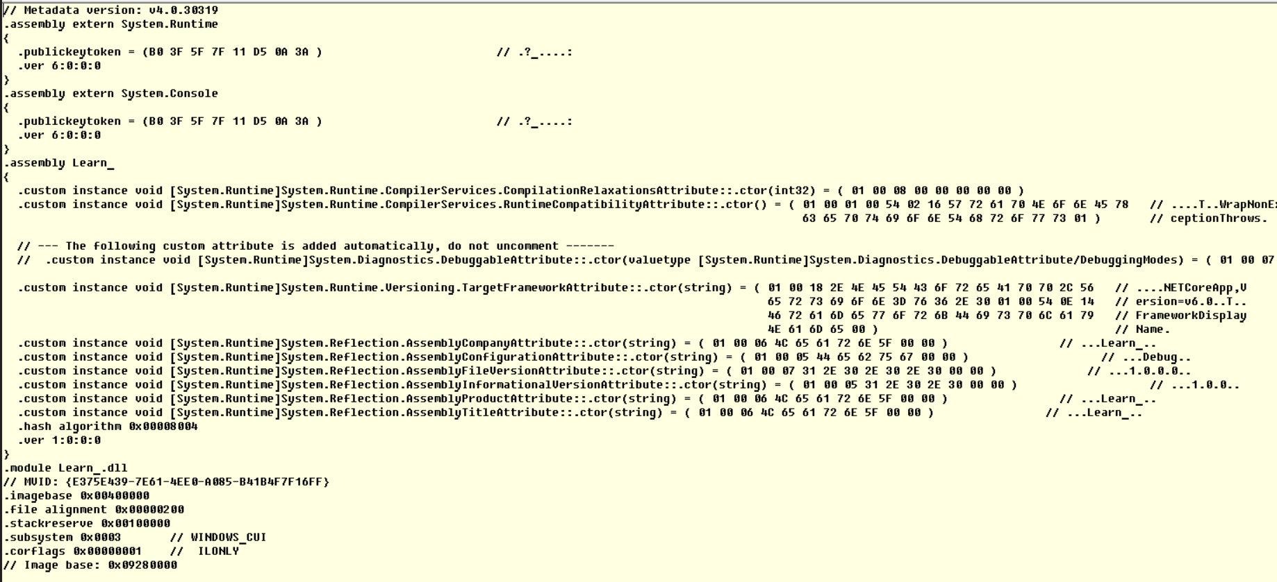
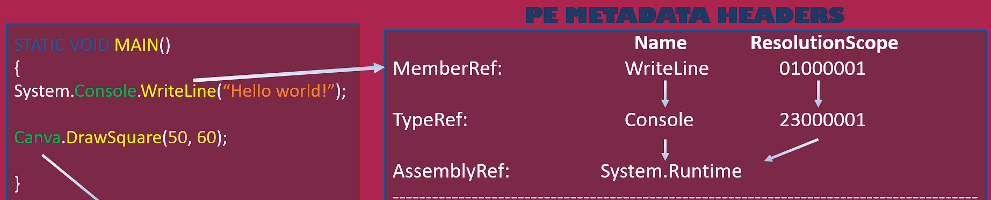
MANIFEST
MODULES STAT. OF PE:
ADDRESS, STACK MEMORY, FLAGS ETC.

Slide 8
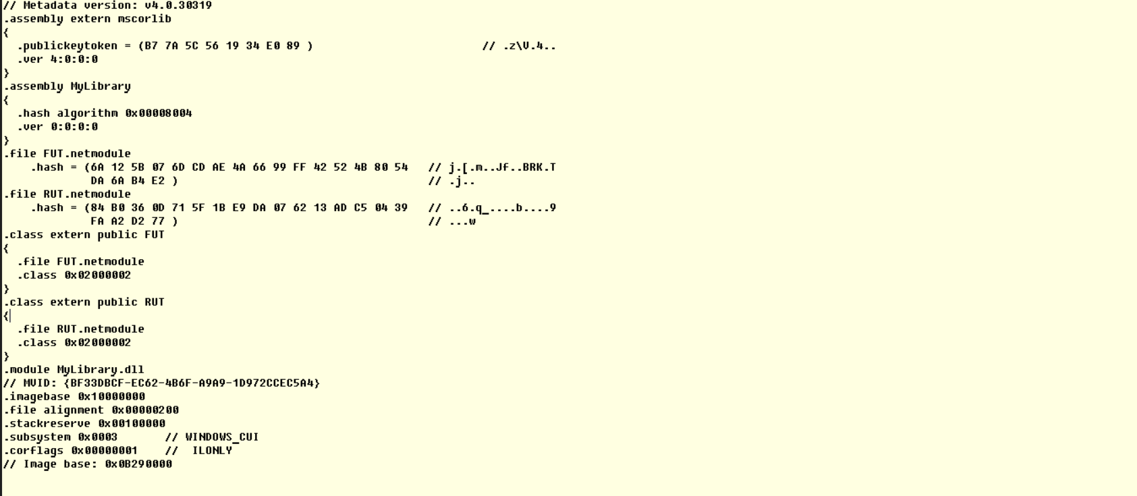
MODULES
From where the file is imported into the PE module

Slide 9
DIGITAL KEYS
PE FILE WITH MANIFEST
MYLIBRARY.DLL
IL - CODE
WHOLE PE FILE
HASH VALUE
RSA DIGITAL SIGNATURE
METADATA
SIGNED WITH PRIVATE KEY
MANIFEST
ASSEMBLY FILE (MyLibrary.dll, RUT.netmodule);
EXPORT FILE (MyLibrary.dll, RUT.netmodule).
PUBLIC KEY
CLR HEADER
EMBEDED IN PE FILE
RSA digital signature
EMBEDED IN PE FILE
PUBLIC KEY

Slide 10
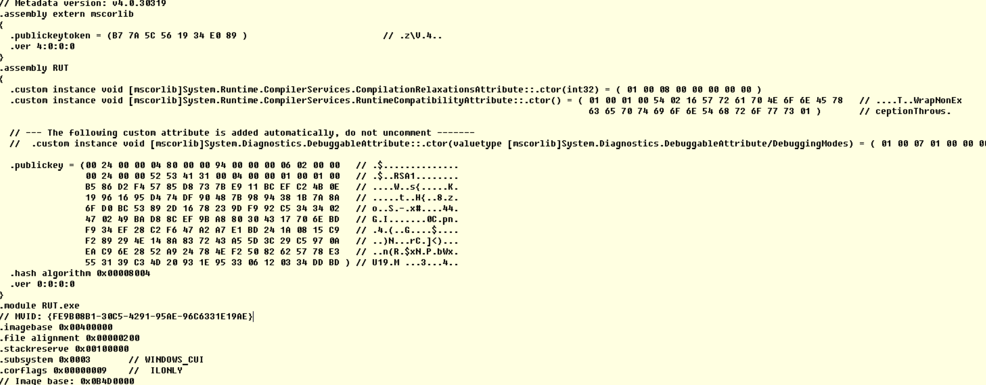
LARGE PUBLIC KEY IN MANIFEST.
FOR HELP ITS, WE CAN PREVENT “NIGHTMARE OF DLL”

Slide 11
THANK YOU FOR WATHCING!
SOURCE

